Slide 1
Truth Functions and Truth Tables
Mirko Farina
Assistant Professor
Innopolis University
* I do not claim authorship for all texts and pictures in the presentation.

Slide 2





Plan
Summary of Previous Lecture
Stoic Logic (Inspiration)
The Basic Unit of Propositional Logic
Connectives (Logical Operators)
How to Individuate the Top Level Operator
Well formed propositions
Exercises
- Truth Functions
Truth Tables
Exercises

Slide 3

EXERCISES
For each of the following expressions, say whether it’s a well formed formula or not . Then say what is the top operator

Slide 4



Translate the following propositions in propositional logic
if Makar passes the exam, Makar will get a new car
Artem needs a parachute if and only if he is planning to jump from the airplane

Slide 5





Let's define propositions and translate some sentences into the logical notation.
“Either John or Mary (or both) are going to the store today.”
“John is going to the store today, but Mary isn’t.”
“The store is open today, and either John or Mary is going.”
p | The store is open today.
q | Mary is going to the store today.
r | John is going to the store today.
p | The store is open today.
q | Mary is going to the store today.
r | John is going to the store today.

Slide 6
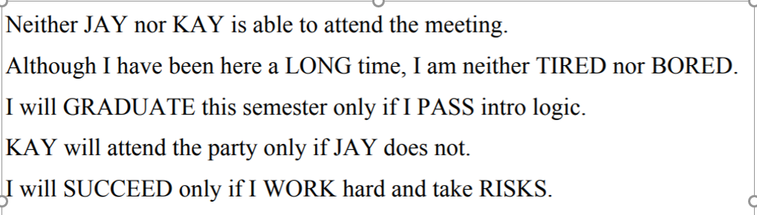















Slide 7
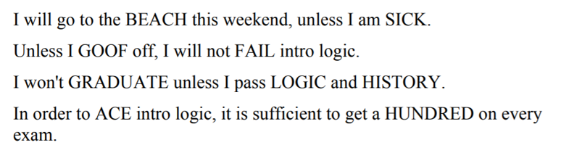














Slide 8




Truth Functions
A FEW THINGS BEFORE WE START:
- Valid Arguments are truth functionals
Bivalence (Law of the Excluded Middle)
There is no middle ground between truth and falseness. A proposition is either true or false. Idea questioned in modern logic by Post, Lukasiewicz and others (trivalent logic)
Today we introduce Statement variables – like in algebra we use them to identity patterns of reasoning that we see (lower case letters; p,q,r,s) – construct universal forms of logical arguments (statement forms)
We use capital letters G,M,C to symbolise particular propositions

Slide 9





- We also introduce Truth Tables
It s a tool for symbolizing the bivalent properties of a statement or proposition ( Take: George is a clown)
Logical operator function differently in accordance to their truth value

Slide 10



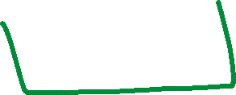











Mirko is going to the market and he is going to buy the bread
Either you see Rome or you go home

Slide 11


















If do your homework, then you will pass the course
You will pass the course if and only if you
do your homework

Slide 12

LET US BUILD THE TABLE …. KEEP IT ALWAYS WITH YOU
IMPORTANT IS BECAUSE THIS CAN BE USED TO COMPUTE THE TRUTH VALUE OF PROPOSITIONS AND ARGUMENTS

Slide 13
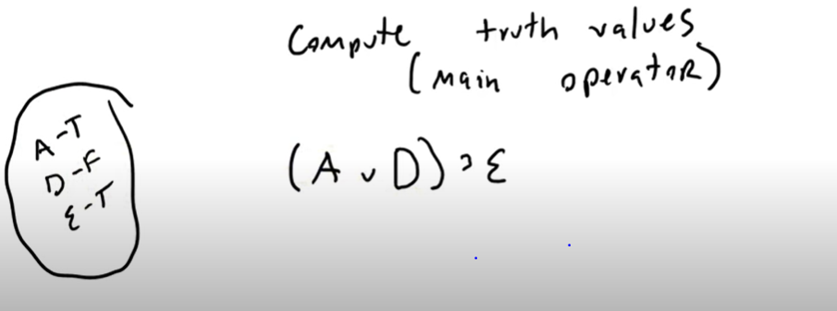




Slide 14





COMPUTE….

Slide 15
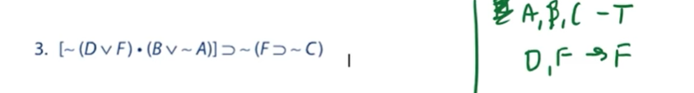





COMPUTE….

Slide 16
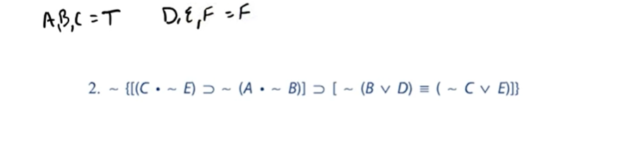

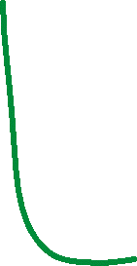






COMPUTE..

Slide 17
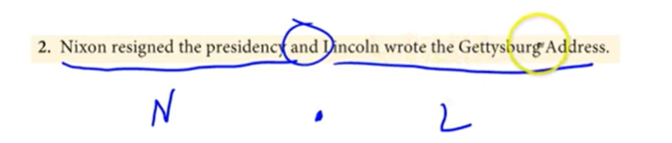






PROPOSITIONS?

Slide 18
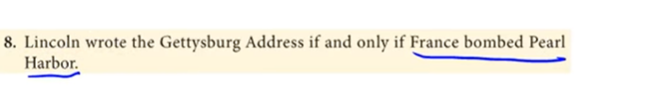



Slide 19




Soviet Union defeated the Nazi and first sent a man to space if and only if Italy had the largest communist part in Europe

Slide 20










Slide 21
WHAT YOU LEARNED TODAY?
WHAT IS A TRUTH FUNCTION = ‘compound proposition whose truth value is completely determined by the truth values of its components’
WHAT ARE THE TRUTH FUNCTIONS FOR CONNECTIVES
HOW TO COMPUTE VALUES OF PROPOSITIONS BASED ON TRUTH FUNCTIONS

